Slide 1
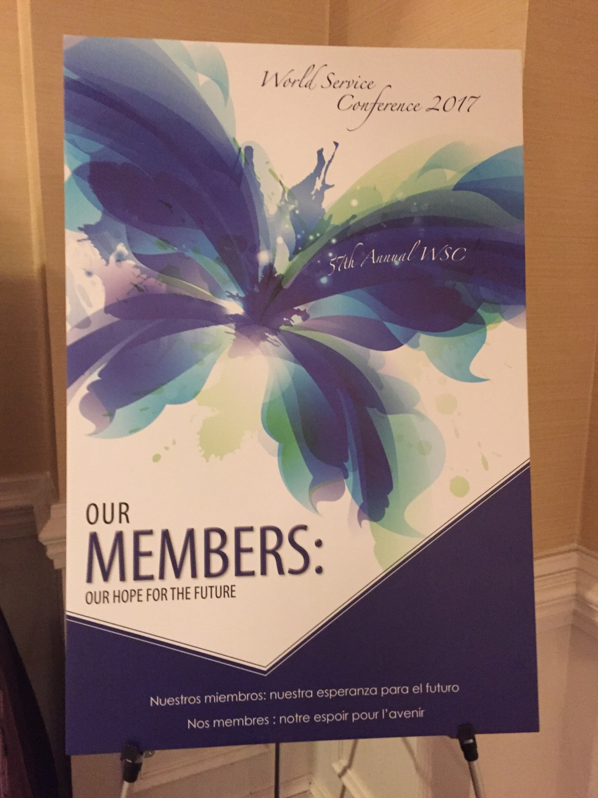

Slide 2
Board Vision Statement:
All people affected by someone else's drinking will find help and and recovery in
every community.
Board Mission Statement:
Anticipate the future and Al-Anon’s place in it and ensure that the necessary
resources are available.
Strategic Plan Priorities of AFG, Inc. Board of Trustless
Al-Anon’s spiritual principle permeate our policies and practices; we apply
emerging technology and communication options:
To increase the visibility of Al-Anon so that it is recognized as the number one
resource throughout the world for helping friends and family of problem
drinkers.
To empower the Al-Anon fellowship to be vibrant, inclusive and flexible.
To achieve a viable future for Al-Anon Family Groups, the Board will be adaptive
and strategic in its use of talents, skills, and abilities.

Slide 3
New Executive Director
May 1 – June 15, 2017
Application and Resume submission period
June 26 – 30, 2017
Video conferencing Interviews
Week of July 17, 2017
Final candidate interviews with the Board of Trustees
Virginia Beach, Virginia
September 5, 2017
Desirable start date for New Executive Director
at the WSO in Virginia Beach

Slide 4
Director of Programs Director of Finance Administrative/Conference
Marsh W Niketa B Ass. Director Conference
Suzanne M
Ass. Director International Events/Project Manager
Kerri K Jacky G
Ass. Director - Groups
Sue P
Ass. Director Professional
Claire R
Ass. Director Media
Pat Q
Ass. Director Literature
Tom C
Digital Strategy Manager
Scott P
Restructuring 18 month trail

Slide 5
New Web Site Design Soon
Public Outreach Site
Smart Phone
“Contribute Now” button

Slide 6
Sharing Area Highlights Topics
Round 1 Topic:
How to encourage Area Participation:
Filling positions
Inactive groups
Members in remote areas
Round 2 Topic:
How can the Area help strengthen Sponsorship”
key to retaining newcomers
how to be an effective sponsor who has grasp of our
encourage newcomers to get sponsor
Round 3 Topic:
Alateen
what is working
young Alateen meetings
promoting Alateen instead of attracting
help Alateen be self-supporting
Round 4 Topic
Delegate report

Slide 7
WSC Agenda Thought Force
At 2016 WSC, a request brought by Delegates who ask for Thought Force to consider
Ways in which Delegates can be more active and directly involved developing
Conference agenda.
History over years
Agenda committee, Admissions committee, CLT
2000’s Delegates no longer directly participated in agenda; Delegate on thought &
task forces participation
Opportunities for Delegates input in place 2016:
Chosen Agenda Items
Board of Trustee calls
Participation in committees, task and thought forces
WSC evaluations
Floor motions
Voting for theme and speakers
AFG connects
Literature committee, Policy committee or Outreach committee
Delegates survey
No task force

Slide 8
International Representatives
New Zealand
Arnold H
UK & Eire
Kim A
Mexico
Maria de Jesus Oliva M

Slide 9
Al-Anon International
36 GSO around the world

Slide 10
Chosen Agenda Item #14
How to attract younger members & keeping them after they attend?
What are some barriers affecting newcomers from coming?
Are we there for newcomers, giving them our numbers or do we invite them to “get in
the car” to attend other meetings (district meetings, Area assemblies, workshops, etc.)
How are we addressing mutigenerational diversity issues?
Time constraints, diversity issues
More discussion to distinguish religion from spirituality
Meetings still use Lord’s Prayer
Alateen not getting recovery so not staying in Al-Anon
Newcomers meetings
Get newcomers involved in service
Healthy groups
Listen & not give advise
Groups include Alateen in their meetings
Sponsor younger people

Slide 11
Chosen Agenda Item #9
How do we get people to step up for service?
Service sponsors
Our future depends on participation by all members
Ways to encourage members to continue spiritual journey to recovery
New ideas for assemblies or conventions
Understanding commitment when step into service position; some try and decide to much
commitment.
Do we fully understand spiritual principles of our Seventh Tradition? This tradition includes
so much more than just contributing financially. Many groups, districts, Areas struggle
to get members to participate in service.
Workshops on service

Slide 12
Chosen Agenda Item #5
How can we more effectively cooperate with AA, enhancing a relationship with those members and their friends and families who are already aware of the
positive impact of 12-step recovery?
Survey shows 50% of Al-Anon members who’s loved ones got them to Al-Anon
are AA members
What is “Cooperation”? Cooperation is working with others outside our program, providing information about who we are, what we do and how to reach us. The pamphlet, Attracting and Cooperating (S40 ), defines cooperation as :providing
literature, meeting schedules and telephone contact numbers to professionals.
Setting up display booths or “take one” tables at outside conventions, conferences and health fairs. Giving Al-Anon and Alateen presentations to family members
and staff at facilities. Responding to requests from media and professional for
Al-Anon and Alateen information. Offering Al-Anon and Alateen members’ services to share how program works for them.
Al-Anon guideline, Al-Anon/Alateen participating in an AA Convention (G07)
Link on the Al-Anon website to AA
Family disease
Be visible, to build a bridge with AA
Speaker exchange

Slide 13
Terminology “Open” and “Closed “ meetings
Policy Committee opened discussions at 2016 WSC Open Policy Meeting
The primary focus on principle of welcoming (Tradition Five) and maintaining anonymity of members (Tradition Twelve).
Feedback
Are terms confusing to some member as well as prospective newcomers, professional and public agencies?
Do we look like a closed society? Unwelcoming
3 questions:
How well do members in our Area understand the difference between an open and closed meeting? Do group members know if their meeting is listed as open or closed?
2. How do students and professional find out about Al-Anon in your Area? Are the closed meetings in your Area providing a monthly open meeting?
3. Is the original purpose of open meetings obsolete? Has internet, social media, numerous self-help books, active public outreach etc., eliminated the need to designate meetings as open or closed.

Slide 14
Welcoming friends & families of drug addictions
Can’t change our primary purpose
Educate people
How to be more welcoming, open
Let people know about Nar-Anon

Slide 15
Tradition 7. Every group ought to be fully self-supporting, declining outside contributions.
Literature Contributions
57% 23%
63% 25%
Literature sales 50% 2,700,000
Contributions 38% 2,100,000
Forum 5% 250,000
Investments 7% 190,000
Where contributions come from?
Groups 758,837
Online 37,938
Other 27,909
Birthday 10,997
Individual 155,506

Slide 16
What do we spend money on?
Operating expenses
1. Programs
media, outreach, PSA (3 languages), 9 TEAM events, 3 Zonal meetings( Europe,
Central America, South America), IGSAM, literature, Board of Trustees travel,
conference, new redesigned web site, protect trademarks, membership surveys
every 5 years
2. Literature distribution
postage (will decrease, suspend complimentary Forum), volunteers
new literature
3. General Administration
fully staffed, survey staff looking ways to cut cost, office reorganized ,
focus on technology (hired Digital Strategist)
4. Printing
conference summaries, service manuals, conference notebooks

Slide 17
Operating expenses
2016 actual 4,883,029 projected 2017
4,883,029 5,161,500
Projected increase of 4.4%
Filled staff vacancies from 2016
Added one new position of Webmaster
Increased Travel due to Zonal meetings
Projected revenue
2016 actual projected 2017
5,033,270 5,240,000
Does not include Reserve fund income or transfer

Slide 18
Summary of 2017 Budget
Total Expenses Actual 2016 2017 Budget
4,945,117 5,229,500
Total Revenue Actual 2016 2017 Budget
5,033,270 5,240,000
Net increase/decrease 88,153 10,500
Small surplus!

Slide 19
Reserve Fund Now
1 year operating expenses 5,000,000
Net Value of Reserve Fund 3,600,000
Short 1,400,000
Warranty 1. that only sufficient operating funds, including ample reserve, be it’s prudent
financial principle

Slide 20
Estimated cost of services to groups $3,696,925
Average cost of service to group 261
2015 2016
Indiana 67% 12,961 13,816
Other*
Contributions from individuals
AIS’s, LDC’s & Ares meetings 3,205 3,333

Slide 21
World Service Office

Slide 22
Lois’s typewriter
from office

Slide 23
Panel 55

Slide 24
“World Service Handbook” Task Force
World Service Conference
World Service Office
Conference Structure
Conference Procedures
Election Assembly Procedure
General Information for Assemblies
Duties of Assembly Members
Area World Service Committee
Interim Assemblies
District Meetings
Service Structure of Al-Anon
Some terms didn’t exist
“Alternate” GR
Region (9 regions; 6 US & 3 Canada)

Slide 25
“Announcing Events at Meetings”
P. 85-86 and 123-124 in the Membership and Group Meetings/conventions section of
Service Manual
Announcing events
If Al-Anon is participating in event may announce; AA event with Al-Anon participation
Ask to use spiritual principles:
Cooperation
Participation
Responsibility
Singleness of Purpose
Unity or Common Welfare
Autonomy of service arms when announcing events
May chose to announce only events sponsored by Al-Anon service arms
Don’t use “retreat” has religious connotations & could imply affiliation

Slide 26
Amendments to By-Laws
Board of Trustee formed a Task Force to create timeline to recruit, job description .
hire position of Director of Business Service. During the process of developing a
New job description for Director of Business Services, the position was changed to
Director of Finance.
Article V – Powers and Duties of the Trustees

Slide 27
Board of Trustees ……
Big question
How can we empower our members in the use of our
legacies and policies when seeking solutions to issues
within the Area, District and group?

Slide 28
What are our Al-Anon/Alateen Resources
Three Legacies
Groups at Work
World Services Handbook
Members Website
Guidelines and Alateen Service e-Manual

Slide 29
WSO’s Purpose
To provide services to help individuals and groups worldwide……
As a Clearing House Not Authority
World Service Office is an arm of the Conference, not a decision making body
Headquarters’ Original Purpose
To carry out, for Al-Anon, what the groups or Area could not on their own..
Solutions to issues
Many answer are available
Some solutions require more in-depth research
Others situations are new and need to be reasoned out
Talk to each other
Reason things out

Slide 30
Why Do Member Seek Solutions Outside Themselves?
May just be learning the Twelve Traditions and Twelve Concepts
Want to find a solution quickly
Hope to resolve conflict
Can’t find topic in Service Manual Index
Encounter a baffling situation

Slide 31
The Policy Digest Offers….
Guidance, not rules or specific answers
Shared experience from the fellowship
Interpretation of our basic guides:
Twelve Traditions & Twelve Concepts

Slide 32
Issue of concern Identify individual (s) or service arm involved or
affected
Example: Member selling jewelry before and after home group meeting
Service Level Determine whether this issues yours to solve
Example: Group
Policy/Legacies
Read Conference Approved Literature
Twelve Traditions and Concepts for insight into
Conflict Resolution using Twelve Traditions (S72)
Review Policy Digest
Example: Policy Digest, pp. 97-98
Traditions Three
Traditions Five
Traditions Six
Talk with Others Reason things out with a service sponsor or
experienced member
Research previous similar situations
Discuss Talk to Each other…Resolving Conflicts
within Al-Anon (S-73)

Slide 33
Talk with others Conduct KBDM to make informed
group conscience.
Spiritual Principles Identify spiritual principles involved
Turn over to Higher Power
Wait, or postpone any actions,
remaining open to more information
Example: Primary Purpose Unity
Steps to Resolution Take your own personal inventory,
considering important traits of a
leader entrusted with the Right of
Decision, guaranteed in Concept Three
Seek an acceptable outcome for
everyone involved, based on the
knowledge and spiritual principles
in Al-Anon’s Legacies & policies
Example: After reading the Policy Digest and discussion about traditions, a few
members are asked to talk to the member about selling jewelry about
Al-Anon’s principles

Slide 34
Members feel capable
Learn to apply the principles in multiple situations
Gain Confidence
Self-reliant
Self-respecting
Find solutions based on principles, not emotions or reactions
Learn to trust themselves, other and Higher Power

Slide 35
Road Trip 2017
You and Your Board Connect
October 21, 2017
Aurora, Colorado
One day event for Al-Anon members to meet Board of Trustees and Executive Committee
members to discuss importance of fellowship and organization.
Saturday October 20, 2018
?

Slide 36
Groups Records Update
WSO groups records 46 groups “reported not meeting” ( new meeting status) . Allows
WSO to stop directing to groups that aren’t meeting. Temporarily removed from WSO
toll-free meeting line. Research results and verify meeting.
43% (20 meetings) were actually meeting; no signage in building to direct people or
locations instructions on group record, moved to another location.
26% (12 meetings) no longer meeting; disbanded and didn’t notify WSO
Remaining meetings still being verified

Slide 37
WSO social media reached combined audience of 3.3 million and produced
65,000 engagements. People liked, shared, or posted comments 65,000 times
for WSO social media on Facebook, Twitter & Instagram during first quarter of 2017
52 million new PSAs during first 2 month 2017
Volunteer can now play PSA on smart phone by going to al-anon.org and clicking on
“Media”. Will play including captions. Can share personal story and give Al-non
Faces Alcoholism magazine.
To deliver PSAs to TV or radio station WSO needs name of station, along with name
and phone # of contact person at station. Electronic copy delivered in few minutes
30% US household families have been affected by someone’s drinking
50% Canada

Slide 38
Literature Update….Tom Coffey
Parents & Grandparents of Young Problem Drinkers
Freelance writer /editor selected
Literature committee reviewing
2018 World Service International in English, Spanish & French
Intimacy in Alcoholic Relationships (working title)
Freelance writer/editor and reviewing
2018 International Convention in English
New Daily Reader ( no working title)
10,682 sharing's
No deadline in submitting sharing's or publication
Request more Forum Legacy sharing's
The Forum Book (working title) need more request for Forum articles you
want included in this book

Slide 39
Lois W. & the Pioneers
Free audio downloads
Full audio (MP3 file) interviews of Lois, Henrietta and Margaret
Go to Al-Anon .org/members
Enter password
“Inside WSO”
“History of the WSO & Al-Anon”
Under “Archives”, click on “Lois W. & Pioneers Audio Interview”
Part 1 is 56-minute interview with Lois in her 90’s
Part Two is 54-minute interview with Lois, Henrietta and Margaret

Slide 40
AFA 2018
New “Help and Hope for Families and Friends of Alcoholics”
Title & year of magazine in lower portion of cover with less prominence
Small block of text to let reader know AFA is free & can be taken home

Slide 41
Order AFA online
Deadline for1st printing is July 5, 2017
2018 Al-Anon Membership Survey for US, Canada, Puerto
& Bermuda
Members will be ask age (previous survey ask how long
attended
46% members reported being referred by professional

Slide 42
Board of Trustees
Teri M
Norm W
Executive Committee
Chairperson Paula B
Executive Director Mary G
Board of Trustee Debbie G
Treasurer Jeanie M
Chairperson of Policy John M
Member at Large Connie H
Member at Large J. T. M
Staff Member Marsh W
Director of Finance Niketa B
ECRPM Sue C

Slide 43
Prayer for Today
Why redesign our history
Spiritual/religion
Mixed
Who makes decision to remove from Newcomers packet?
Executive Committee
No further discussion now
Area can continue discussion and make recommendation to literature
committee

Slide 44
Open Policy Meeting
There is an increase in members attending electronic meetings and how these members/ groups can be included and supported in the spirit of Tradition One.
Online meetings emerged in 1990’s as technology emerged. The first online meeting
in 1998. There is On-Line Information Service (OLAIS) established in 1997 to register
and list Al-Anon online meetings. OLAIS hosted hospitality suite at international
in Salt Lake City. In 1998, the Fact Sheet for Al-Anon On-Line Meetings (S-60).
Policy Committee authorized World Service Office to register on-line meetings and WSC
confirmed. In 2006, WSC adopted the “Electronic Meetings policy. Electronic meetings
include phone, online (including Facebook), email, chat, bulletin board and voice-over-
internet provider (Skype) and occur in English, French, Spanish, Danish, Estonian, German,
Polish, Portuguese and Russian.
There are thousands of people who participate in unregistered “secret”, “closed” or
“public social media” meetings that use the Al-Anon name.

Slide 45
How can we carry the message to others?
How do we extend the spirit of Tradition One to the thousands of Al-Anon and
Alateen members who practice the Al-Anon program using new and evolving media.
2. In the spirit of Concept Four, how can we welcome the thousands of Al-Anon and
Alateen members who patriciate in these meetings into our service structure.
Collect data, get to know what services they would want, profiles visible sharing’s not

Slide 46
Cost cutting efforts
No conference summaries
No service manuals
Available online
Groups purchase service manuals $5.00
Groups at Work 1.00

Slide 47
European Zonal Meeting
August 18-20, 2017 Essen, Germany
Central American Zonal Meeting
May 18-20 Antigue, Guatemala
Ibero-American Zonal Meeting
October 154-15, 2017 Ecuador
Zonal meetings are informational meetings for counties with General
Service Offices and evolving service structures.

Slide 48
2018 International
Baltimore, Maryland
July 2018
Celebrating One Day at a Time
50th anniversary of daily reader “One Day at a Time”

Slide 49
Total Al-Anon/Alateen groups
worldwide 2016 24,919
US/PR/BDR Al-Anon 12,785
US/PR/BDR Alateen 866
Canada Al-Anon 1,217
Canada Alateen 56
International Al-Anon 9,307
International Alateen 687
Al-Anon Members Involved in Alateen Service 4,585
Electronic meetings 157

Slide 50
What can I do?
Johnathan WSO worker

