Slide 1
INDIANA AREA 17 DELEGATE REPORT
Maureen Hughes Panel 61
“The Legacies Live On!”
June 5, 2021

Slide 3
World Service Conference April 12 – 16, 2021
Moving Forward with Unity, Courage, and Perseverance
Avancemos con unidad, valor y perseverancia
Allons de l'avant avec unité, courage et persévérance

Slide 5
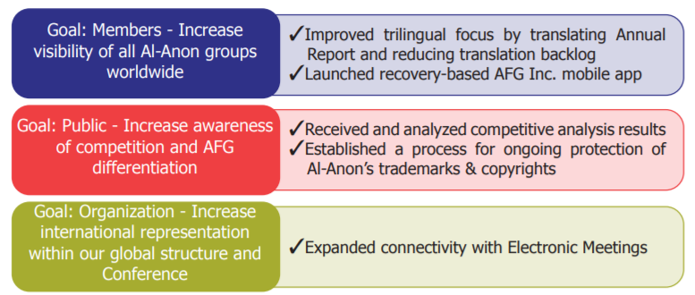

Slide 6
July 2021 Chairperson of the Board Letter
2022 World Service Conference will be in Tarrytown, New York!!!!
Theme:

Slide 7
July 2021 Chairperson of the Board Letter
WSO Finance Update:
~ The revised 2021 Budget has been approved, with a $233,753 deficit.
~ 2021Literature sales are above YTD Budget by $86,831.
~ YTD WSO contributions are below Budget by $111,557.
2022 Delegate Expense: Equalized Expense Amount is $2,137 (US); Full Amount is $3,053.12 (US)

Slide 8
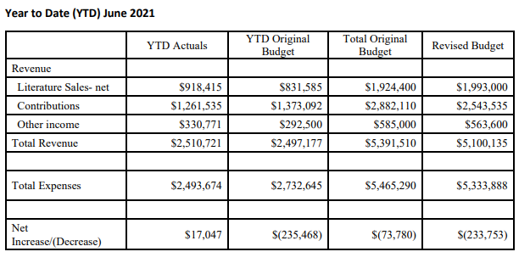
2020 YTD Finance Report Cindy M., WSO Treasurer

Slide 9
July 2021 Chairman of the Board Letter
2021 Road Trip! You and Your Board Connect, Cleveland, OH has been postponed after careful consideration.
Strategic Planning: The Strategic Leadership Team completed a 2022 Strategy Options session. Goals and Envisioned Future of the AFG, Inc. Strategic Plan. SLT will present at the October 2021 Board meeting where the Strategies will be given final approval. The 2022 Strategies will be announced in the October 2021 COB Letter. It has been almost three years since the current Strategic Plan was approved by the Board.
Compensation Committee: A Compensation Consultant has been engaged who will make a report to the Board of Trustees at the October 2021 Board meeting, due to the delay in this 3-5 year review in 2020..
Alateen Certification: Last year the Board passed two motions, one which established a WSO Al-Anon Member Involved in Alateen Service (AMIAS) training program, and the second, which required Trustees and Executive Committee members to become certified AMIAS through the WSO AMIAS Program. The very first WSO AMIAS training, led by Sue P., Associate Director—Group Services, was provided to Trustees, Executive Committee members, WSO Conference Staff, and Group Services.

Slide 10
July 2021 WSO Policy Committee
A new Task Force, Public Outreach in Relation to Social Media, brought an interesting discussion forward, reflecting on the term “local,” especially in this age of globalization. We look forward to this group bringing back additional thoughts, questions, and insights to the October Policy Committee for another thought-provoking conversation.
Two other Policy Task Forces, Announcing Events and Local Services, have continued to meet and to offer updates to the Policy Committee. More detailed information will follow after the October Policy Committee Meeting.

Slide 11
WSO News
Copy Editor Position: Position based in Virginia Beach! This job is located at the Al-Anon Family Group Headquarters, Inc. World Service Office in Virginia Beach, VA. Remote employment will not be considered for this position. Spanish bi-lingual is a plus. Please contact Human Resources with any questions or to apply cthomas@al-anon.org.
WSO Alateen Literature Committee or Public Outreach Committee Volunteer Opportunity: To serve as an At Large Committee members if they are 13 and have 1 year Alateen membership. Resumes are being accepted through Friday October 29, 2021.
https://al-anon.org/pdf/At-LargeCommitteeResumeForm7-13.pdf

Slide 12
Electronic Meeting Workgroups
Geographic Areas have a year before the WSO can provide them the opportunity to begin registering groups which meet only electronically.
Areas can take as much time as they need before deciding when and how to begin registering groups which meet electronically.
April 2021 – March 2022:
Areas discuss and decide whether and how they might accept groups which meet only electronically in their service structure—defining Area policies and procedures, if appropriate.
WSO supports groups which meet only electronically in the non-panel Area to elect GRs, a temporary chairperson, and a Delegate.
WSO makes changes to group forms, database systems, and the Online Group Records platform to enable geographic Areas to welcome these new groups and begin maintaining their group records.
April 2022: WSC members consider admitting the new Area to the WSC (if the non-panel Area has completed its preparation process).
May 2022: Groups intending to remain geographically local and having the desire to participate in the local service structure may petition a geographically based Area for admission, i.e., permission to move from one Area to another.

